Slide 1





Aws Services used in Pliant Project
Client Data
Data Engine
PharMetrics
vendor
SFTP
Loaded data to redshift using AWS roles
Amazon Redshift DWH Pharmetrics+ LRx
S3-Datalake
LRX
vendor
SFTP
Need Access & Secret key pair
Pulled data using redshift Credentials
Python-Computing Environment
Accessing using registration code
+ User ID + Password
PharmaACE Users

Slide 3
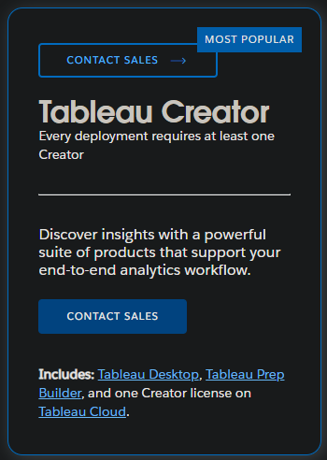
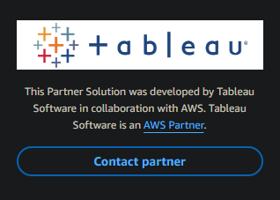
Tableau Setup Process
Two option to do setup of tableau server
Direct Purchase from tableau
BYOL to Aws cloud

